Slide 1
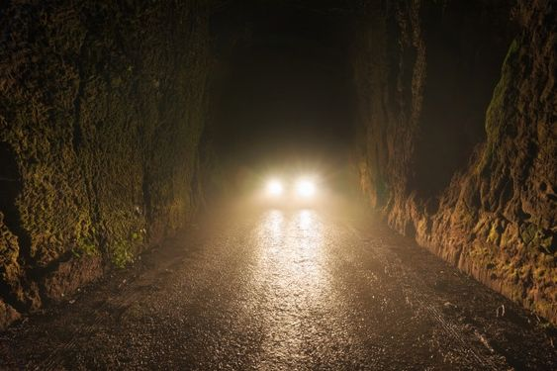
“Choke” by Dan Shea
Directed by Hunter Parker
A Dramaturgical Presentation by Meghan McGehee

Slide 2
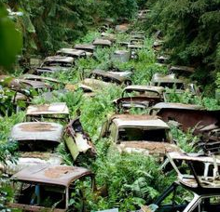
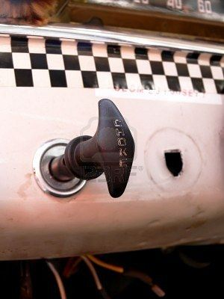
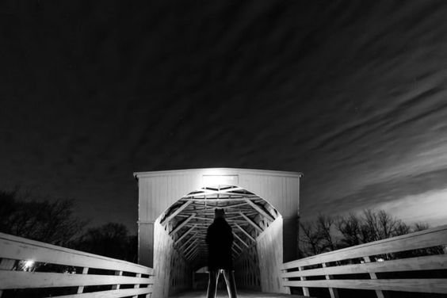
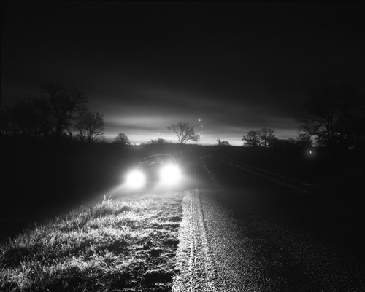
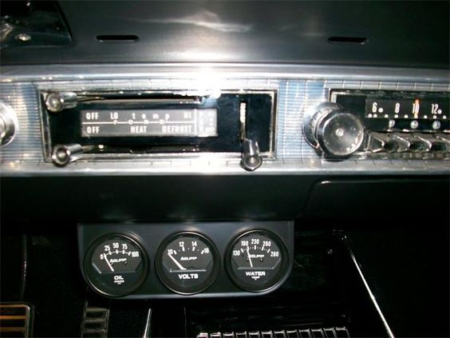
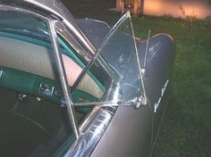

Slide 3
About the Playwright
Dan Shea is a Kansas State University Theatre alumni from the class of 1997. He feels that K-State prepared him for his career in theatre by offering several opportunities in all areas of theatre, whether it be writing, acting, directing, or doing backstage work. After K-State, Dan earned his MFA in Playwrighting at Ohio University. He first wrote “Choke” as a submission for a horror radio play contest held by a Chicago station. This means the piece required no adaptation to be performed for podcast on Kansas Theatre Works. Dan plans to continue to submit the play to short play radio competitions and is considering writing a longer feature focusing on the characters of Mary and Mother. At the moment, Dan is working on writing a feature for Lucas Foster’s (FORD VS. FERRARI) ANVL Entertainment.

Slide 4
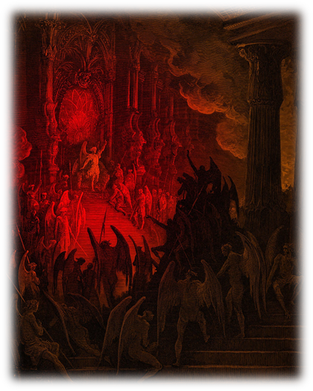
Themes
Religion and Evil
Southern Evangelism
Mary and Mother’s opposing views on religion
Are men inherently good or evil?
Dramaturg’s Notes on Theme
Scan QR Code

Slide 5
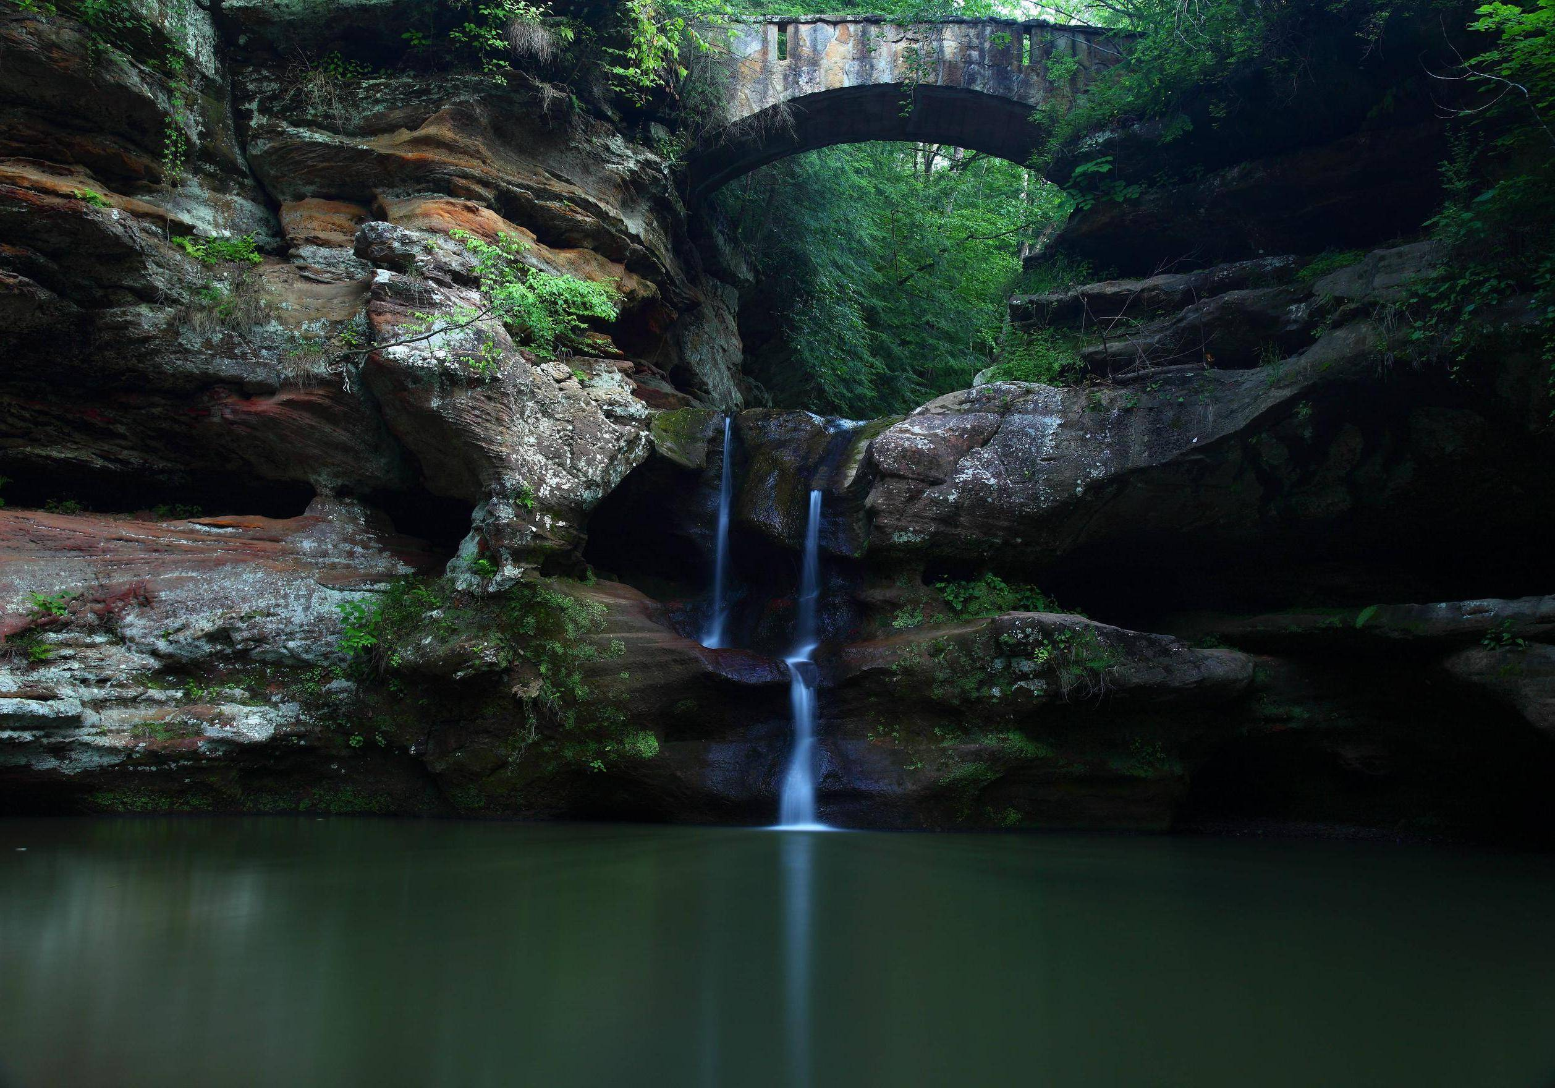
Setting
The play does not have a specified location, but Mary mentions Hocking River Bridge, and later asks the stranger if he is travelling to Chillicothe. This suggests that the play must take place near Hocking Hills State Park in Ohio.
There are no haunted bridges associated with Hocking Hills State Park, but there are three locations within the park that are the center of local ghost stories.
Old Man’s Cave in Hocking Hills State Park

Slide 6
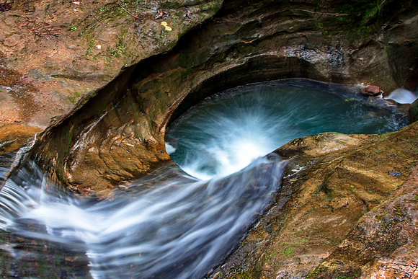
Haunted Areas in Hocking Hill
Ash Cave and Old Man’s Cave
Death Hole
“Ash Cave -A ghostly lady walks the trail at Ash Cave dressed in the clothing of the 1920s and 1930s”
“Old Man’s Cave - A man by the name of Retzler, who once lived near Lower Falls of Old Man's Cave has been greeting visitors in the park with his dogs for over a hundred years. His dog, Harper, has been heard baying in the night deep in the bowels of Old Man's Cave.”
“In August of 1887 while driving a load of wheat to Logan, newlyweds 19 year-old Clara and 29 year-old Johannes Bensenhafer began to cross Scotts Creek, only to have their wagon slip into what is known as the "Death Hole,” a 15 foot pool with undertow. Tragically, they both drowned. After, people heard the ghostly chatter of the couple along Scotts Creek Road and the creek itself. Then, they heard the horses screaming in the area and saw a woman walking by the water.”

Slide 7
Haunted Bridges in Kansas

Slide 8
Theorosa’s Bridge – near Valley Center, KS
There are several version of the origin story of this haunted site. Almost all include a baby drowning in the water under the bridge.
In one of the older versions, Theorosa was a Native American woman who had a child with a white settler and drowned the baby in the river to hide her shame. She was then overwhelmed by grief and jumped into the water after her baby, resulting in both their deaths.
Strange events reported at the bridge include sightings of a ghostly woman, cold breezes, mournful sobbing, and the sound of a baby crying.
Several drivers have also reported their cars randomly stalling in the middle of the bridge.

Slide 9
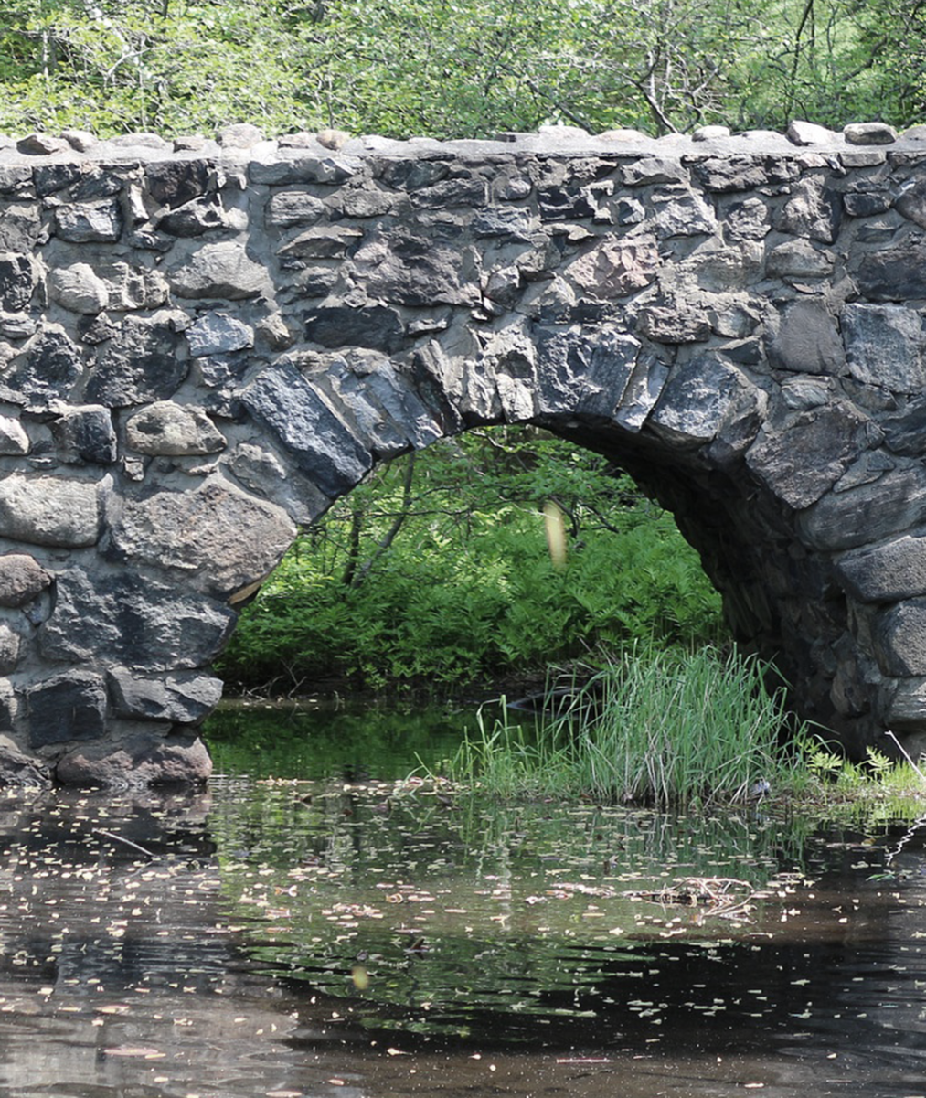
Coon Creek Bridge – Barnes, KS
There is very little information on what may have occurred in the past to cause the haunting of this bridge, but visitors to the bridge have reported that a ghostly little girl can be seen walking through the woods near the bridge.
Sightings of the apparition are most common around sunrise.
Upon further research, death certificates can be found for Betty and Padget Bolejack, two girls who drowned in the pond near Coon Creek Bridge in 1971. Betty was 18 and Padget was only 6.

Slide 10
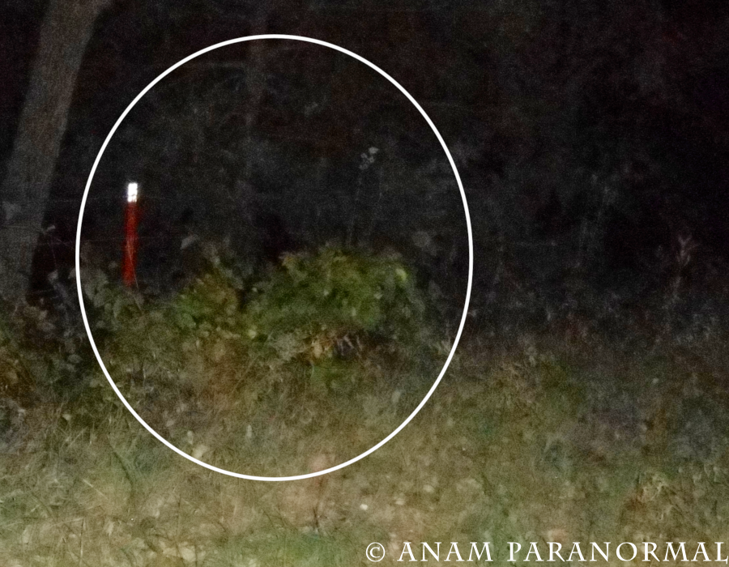
Rocky Ford Bridge, aka Bird Bridge - Emporia, KS
In 1983, Reverend Tom Bird was accused of drugging his wife, Sandy, with the help of his mistress Lorna. The two then made it appear as if Sandy Bird accidentally ran her car over the edge of Rocky Ford Bridge.
No foul play was suspected in the incident until the husband of the Reverend’s mistress turned up dead as well. An investigation was then launched, resulting in the conviction of both Tom and Lorna in the death of Lorna’s husband. Tom was not convicted in his wife’s death until a year and a half later.
A true crime documentary titled “Murder Ordained” was made about the events surrounding Rocky Ford Bridge.
Many have reported hearing a woman’s screams on the bridge late at night. It is believed to be the ghost of Sandy Bird.
Photo taken by paranormal investigators

Slide 11
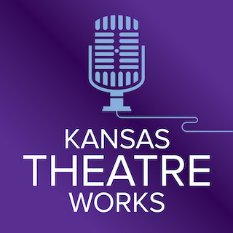
“Choke” airs on the Kansas Theatre Works Podcast along with other short horror plays on Thursday, October 29th. You can tune in wherever you listen to your favorite podcast. Enjoy the show!

